Slide 2
solve various problems relating to trains.

Slide 3
Problem 1
A train 230 m long passes a bridge of length 600 m. What is the distance covered by train in passing the bridge?
Length of Train = 230 m
Length of Bridge = 600 m
Distance covered by train in passing the bridge
= Length of Train + Length of Bridge
= (230 + 600) m
= 830 m

Slide 4
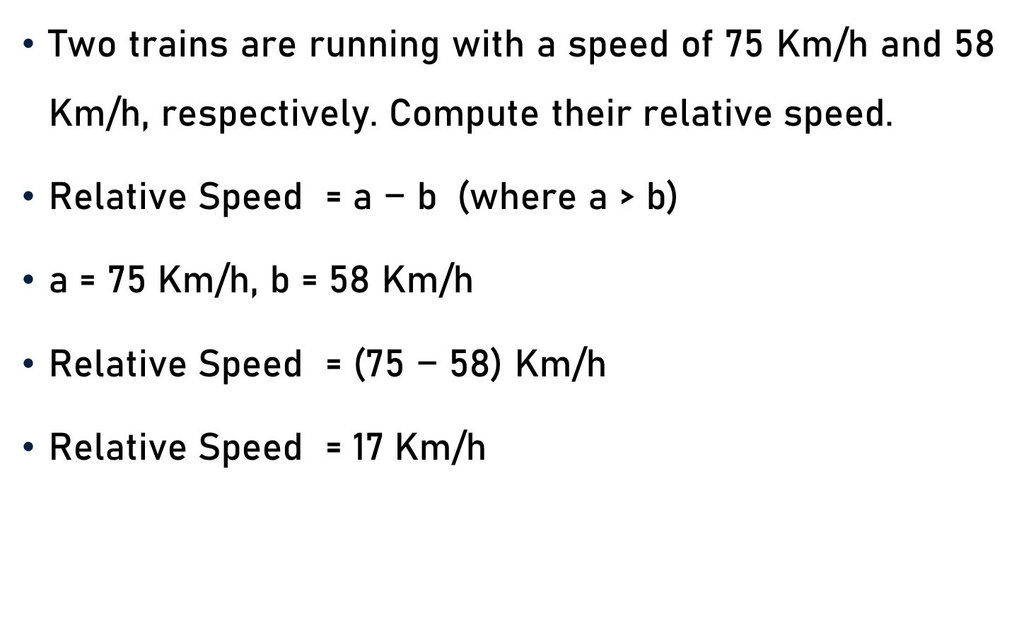
Problem 2
Two trains are running with a speed of 75 Km/h and 58 Km/h, respectively. Compute their relative speed.
Relative Speed = $\text{a}\text{ − }\text{b}$ (where a > b)
a = 75 Km/h, b = 58 Km/h
Relative Speed = ($\text{75 − 58}$) Km/h
Relative Speed = 1$\text{7}$ Km/h

Slide 5
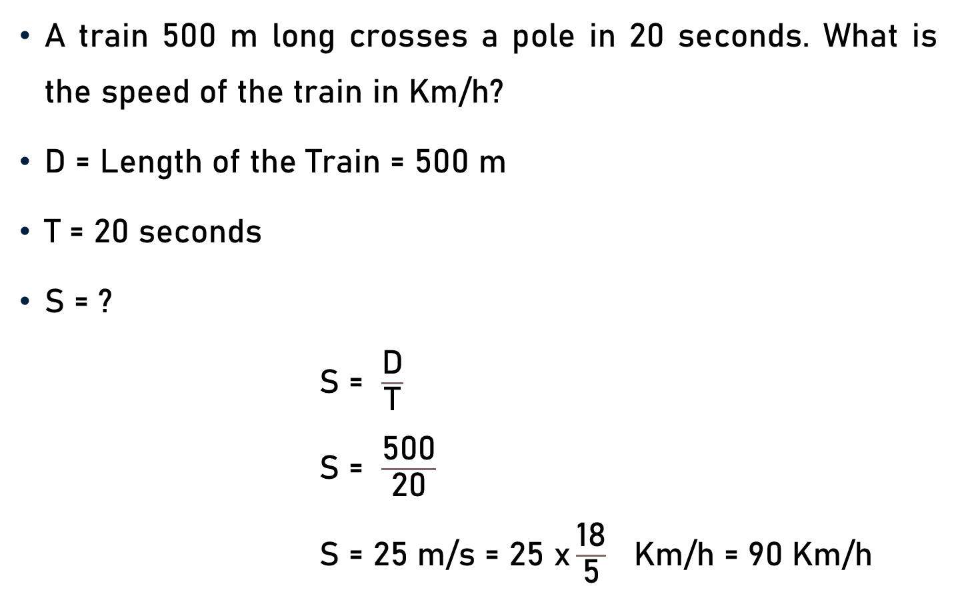
Problem 3
A train 500 m long crosses a pole in 20 seconds. What is the speed of the train in Km/h?
D = Length of the Train = 500 m
T = 20 seconds
S = ?
S = $\frac{\text{D}}{\text{T}}$
S = $\frac{\text{50}\text{0}}{\text{20}}$
S = $\text{2}\text{5} \text{m}\text{/}\text{s}$ = $\text{25} \text{x}\frac{\text{18}}{\text{5}} \text{Km}\text{/}\text{h}\text{ = 90}$ $\text{Km}\text{/}\text{h}$
25
5

Slide 6
Problem 4
A train 200 m long passes a tunnel in 30 seconds moving at a speed of 25 m/s. Find out the length of the tunnel.
Length of Train = 200 m
D = Length of Train + Length of Tunnel
= (200 + Length of Tunnel) m
T = 30 seconds
S = 25 m/s
Length of Tunnel = ?

Slide 7
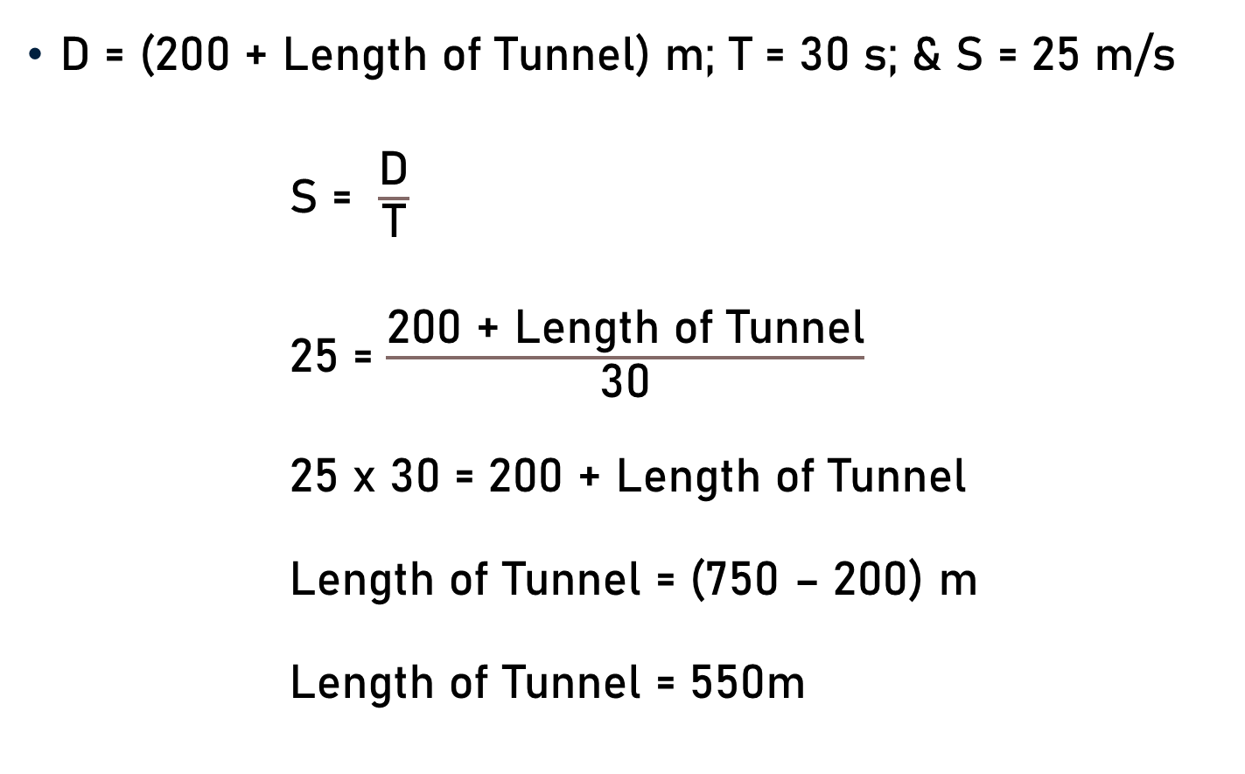
Problem 4
D = (200 + Length of Tunnel) m; T = 30 s; & S = 25 m/s
S = $\frac{\text{D}}{\text{T}}$
25 = $\frac{\text{200 + }\text{Length} \text{of} \text{Tunnel}}{\text{30}}$
25 x 30 = $\text{200 + }\text{Length} \text{of} \text{Tunnel}$
$\text{Length} \text{of} \text{Tunnel}$ = (750 – $\text{200}$) m
$\text{Length} \text{of} \text{Tunnel}$ = 550m

Slide 8
Problem 5
A train 200 m long passes a tunnel of length 500 m at a speed of 25 m/s. Find out the time taken by train to cross/pass the tunnel.
Length of Train = 200 m
Length of Tunnel = 500 m
D = Length of Train + Length of Tunnel
= (200 + 500) m = 700 m
S = 25 m/s
T = ?

Slide 9

Problem 5
D = 700 m; S = 25 m/s; and T = ?
S = $\frac{\text{D}}{\text{T}}$
25 = $\frac{\text{700}}{\text{T}}$
T = $\frac{\text{700}}{\text{25}}$
T = $\text{2}\text{8}$ seconds
28

Slide 10
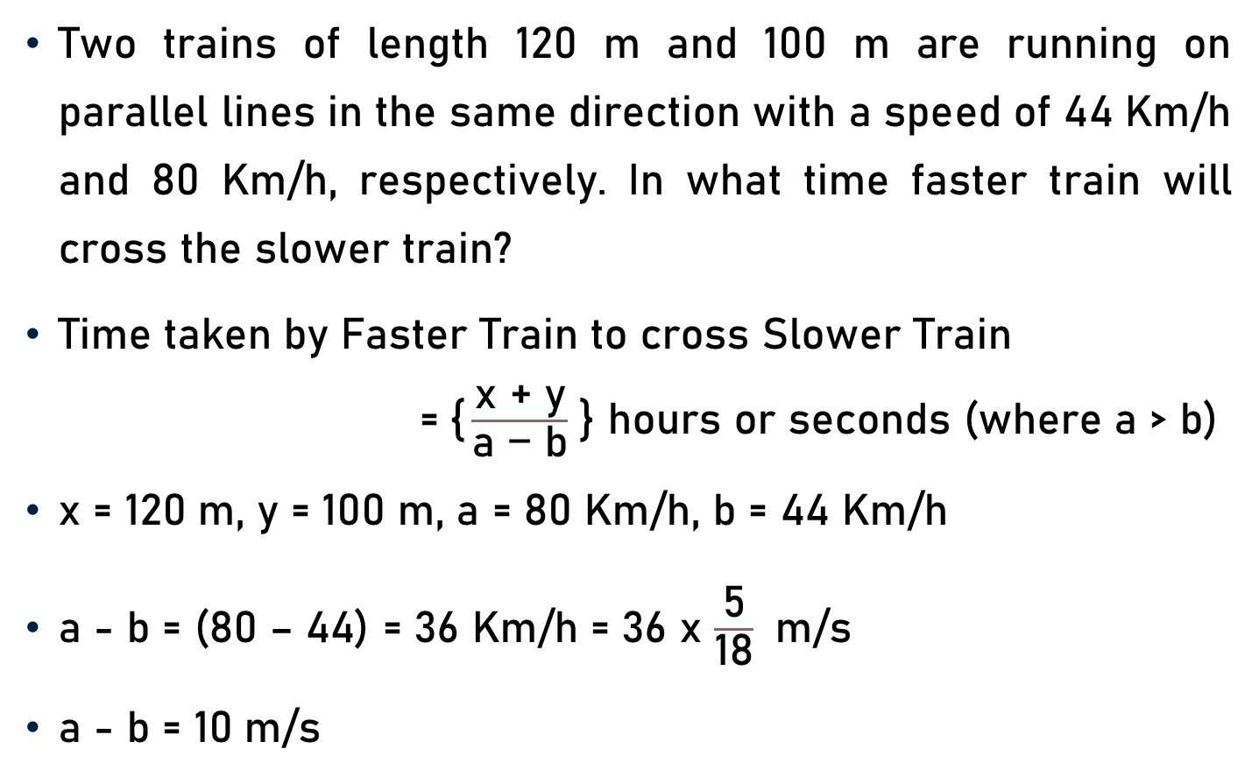
Problem 6
Two trains of length 120 m and 100 m are running on parallel lines in the same direction with a speed of 44 Km/h and 80 Km/h, respectively. In what time faster train will cross the slower train?
Time taken by Faster Train to cross Slower Train
=$\text{\{}\frac{\text{x}\text{ + }\text{y}}{\text{a}\text{ − }\text{b}}$ } hours or seconds (where a > b)
x = 120 m, y = 100 m, a = 80 Km/h, b = 44 Km/h
a - b = (80 – 44) = 36 Km/h = 36 x $\frac{\text{5}}{\text{18}}$ m/s
a - b = 10 m/s
2

Slide 11
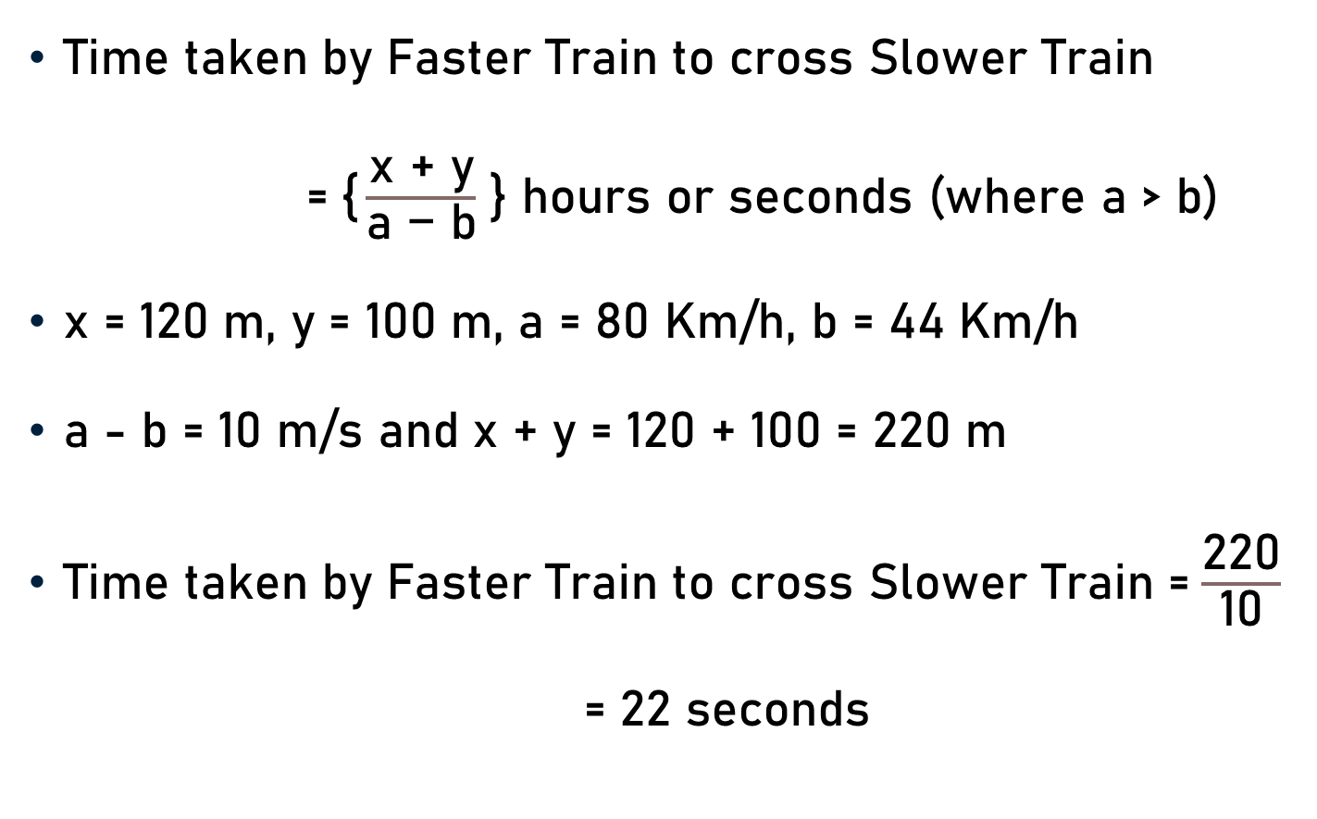
Problem 6
Time taken by Faster Train to cross Slower Train
=$\text{\{}\frac{\text{x}\text{ + }\text{y}}{\text{a}\text{ − }\text{b}}$ } hours or seconds (where a > b)
x = 120 m, y = 100 m, a = 80 Km/h, b = 44 Km/h
a - b = 10 m/s and x + y = 120 + 100 = 220 m
Time taken by Faster Train to cross Slower Train =$\frac{\text{220}}{\text{10}}$
= $\text{22}$ seconds

Slide 12
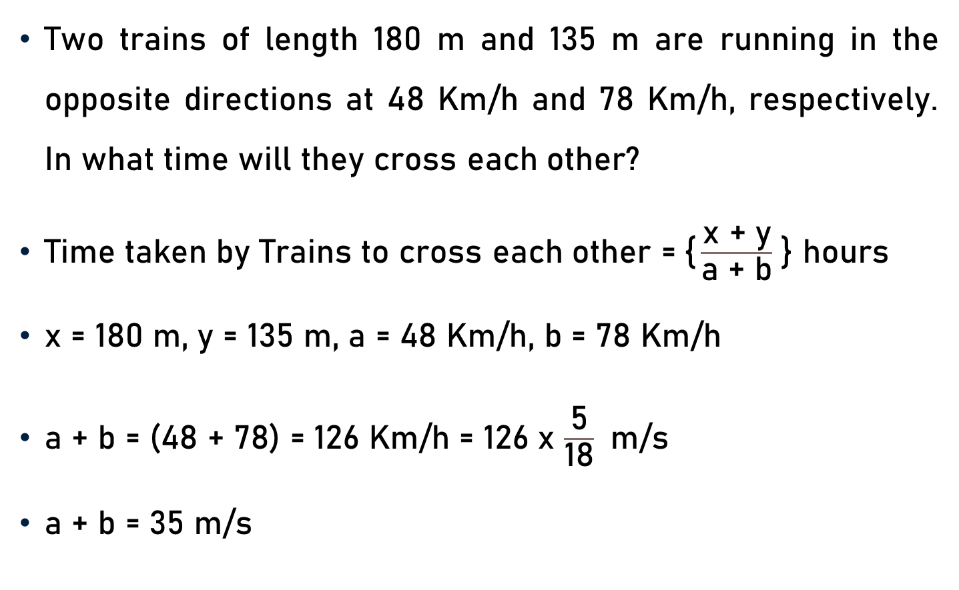
Problem 7
Two trains of length 180 m and 135 m are running in the opposite directions at 48 Km/h and 78 Km/h, respectively. In what time will they cross each other?
Time taken by Trains to cross each other =$\text{\{}\frac{\text{x}\text{ + }\text{y}}{\text{a}\text{ + }\text{b}}$ } hours
x = 180 m, y = 135 m, a = 48 Km/h, b = 78 Km/h
a + b = (48 + 78) = 126 Km/h = 126 x $\frac{\text{5}}{\text{18}}$ m/s
a + b = 35 m/s
7

Slide 13
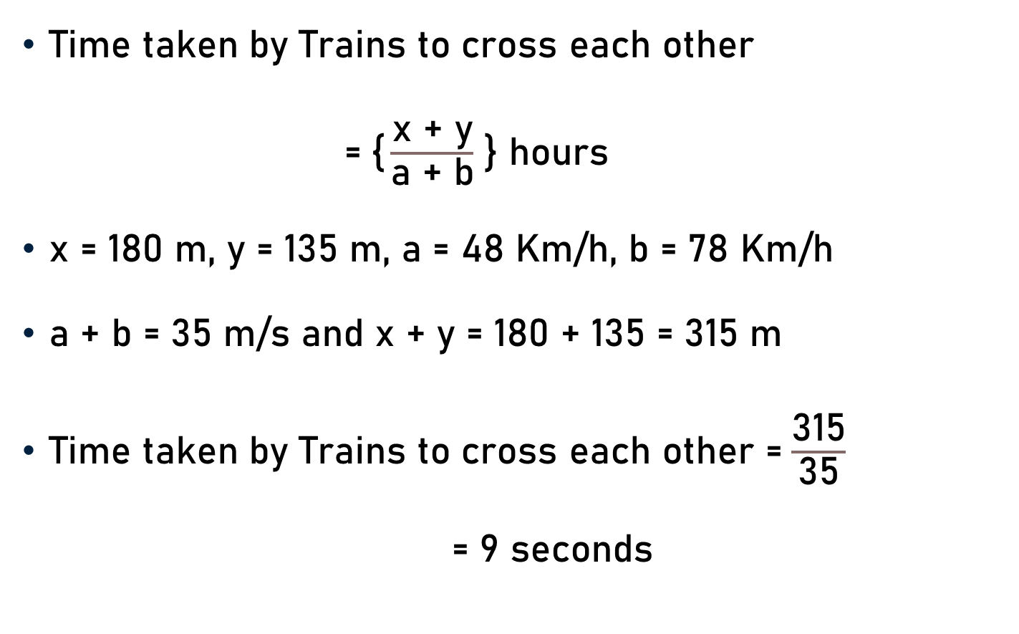
Problem 7
Time taken by Trains to cross each other
=$\text{\{}\frac{\text{x}\text{ + }\text{y}}{\text{a}\text{ + }\text{b}}$ } hours
x = 180 m, y = 135 m, a = 48 Km/h, b = 78 Km/h
a + b = 35 m/s and x + y = 180 + 135 = 315 m
Time taken by Trains to cross each other =$\frac{\text{315}}{\text{35}}$
= $\text{9}$ seconds
9

Slide 14
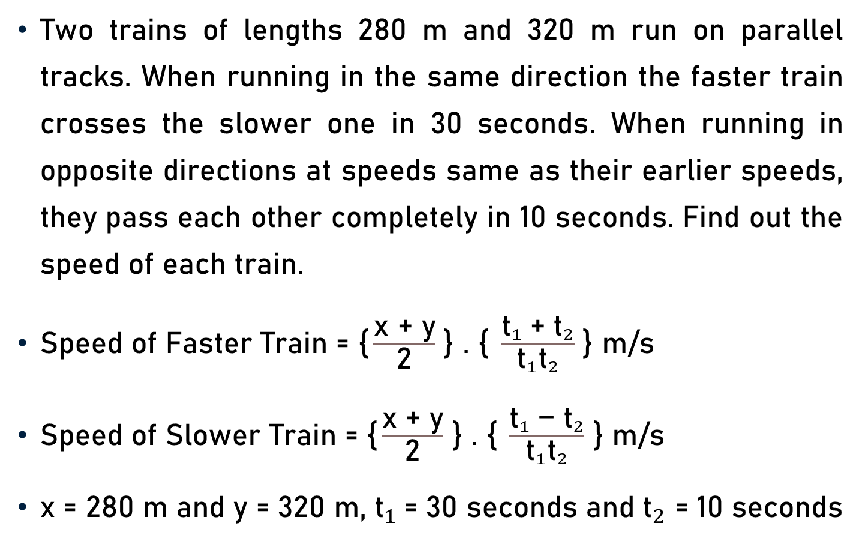
Problem 8
Two trains of lengths 280 m and 320 m run on parallel tracks. When running in the same direction the faster train crosses the slower one in 30 seconds. When running in opposite directions at speeds same as their earlier speeds, they pass each other completely in 10 seconds. Find out the speed of each train.
Speed of Faster Train = $\text{\{}\frac{\text{x}\text{ + }\text{y}}{\text{2}}$ } . $\text{\{} \frac{{{\text{t}}_{1} \text{+ }\text{t}}_{2}}{{\text{t}}_{1}{\text{t}}_{2}}$ } m/s
Speed of Slower Train = $\text{\{}\frac{\text{x}\text{ + }\text{y}}{\text{2}}$ } . $\text{\{ }\frac{{{\text{t}}_{1} \text{− }\text{t}}_{2}}{{\text{t}}_{1}{\text{t}}_{2}}$ } m/s
x = 280 m and y = 320 m, ${\text{t}}_{1}$= 30 seconds and ${\text{t}}_{2}$ = 10 seconds

Slide 15
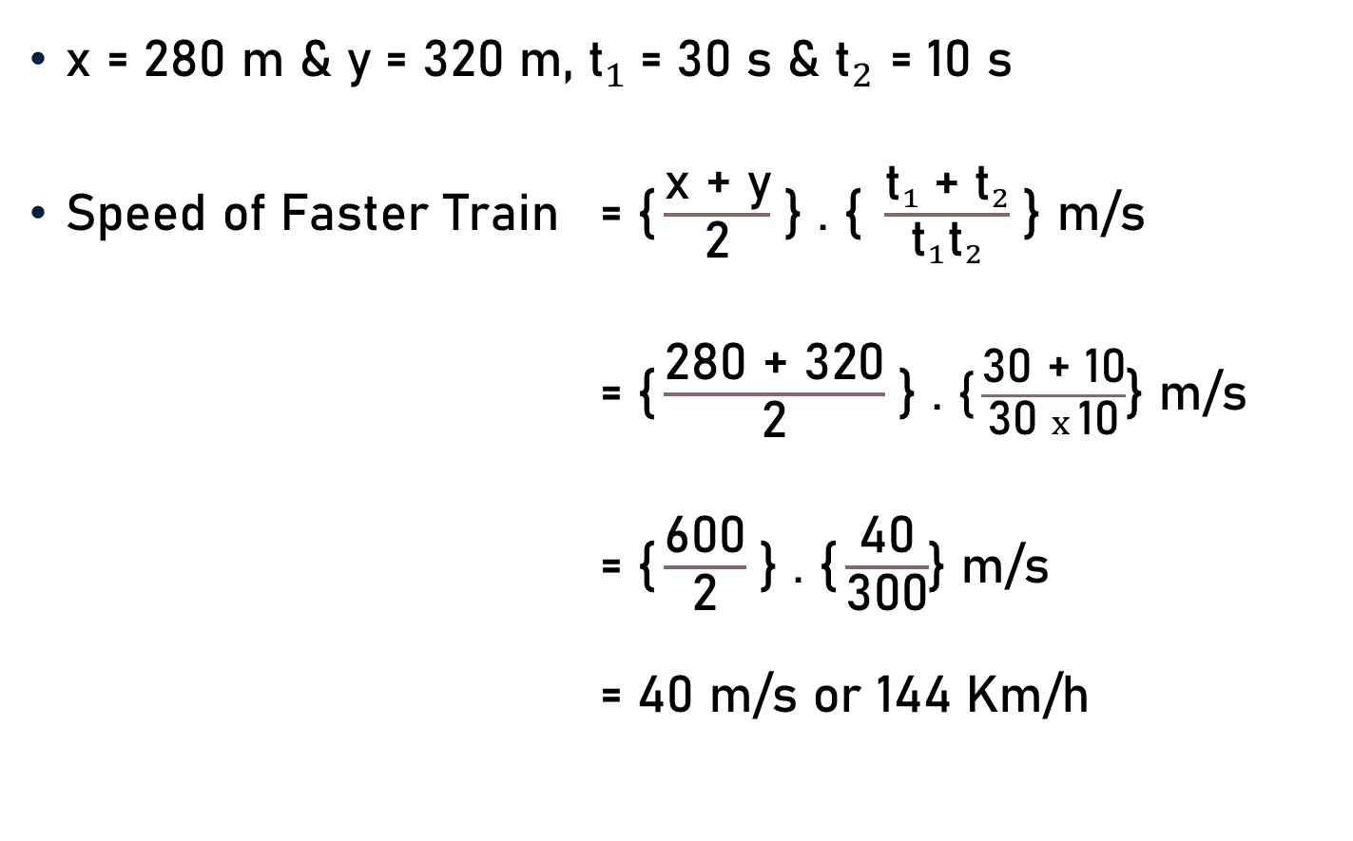
Problem 8
x = 280 m & y = 320 m, ${\text{t}}_{1}$= 30 s & ${\text{t}}_{2}$ = 10 s
Speed of Faster Train = $\text{\{}\frac{\text{x}\text{ + }\text{y}}{\text{2}}$ } . $\text{\{} \frac{{{\text{t}}_{1} \text{+ }\text{t}}_{2}}{{\text{t}}_{1}{\text{t}}_{2}}$ } m/s
= $\text{\{}\frac{\text{280}\text{ + }\text{320}}{\text{2}}$ } . $\text{\{}\frac{\text{30}\text{ + }\text{10}}{\text{3}\text{0 }x \text{1}\text{0}}$} m/s
= $\text{\{}\frac{\text{600}}{\text{2}}$ } . $\text{\{}\frac{\text{40}}{\text{300}}$} m/s
= 40 m/s or 144 Km/h
2
20

Slide 16

Problem 8
x = 280 m and y = 320 m, ${\text{t}}_{1}$= 30 s and ${\text{t}}_{2}$ = 10 s
Speed of Slower Train = $\text{\{}\frac{\text{x}\text{ + }\text{y}}{\text{2}}$ } . $\text{\{} \frac{{{\text{t}}_{1} \text{−} \text{t}}_{2}}{{\text{t}}_{1}{\text{t}}_{2}}$ } m/s
= $\text{\{}\frac{\text{280}\text{ + }\text{320}}{\text{2}}$ } . $\text{\{}\frac{\text{30} \text{−} \text{10}}{\text{3}\text{0 }x \text{1}\text{0}}$} m/s
= $\text{\{}\frac{\text{600}}{\text{2}}$ } . $\text{\{}\frac{\text{20}}{\text{300}}$} m/s
= 20 m/s or 72 Km/h
2
10

Slide 17
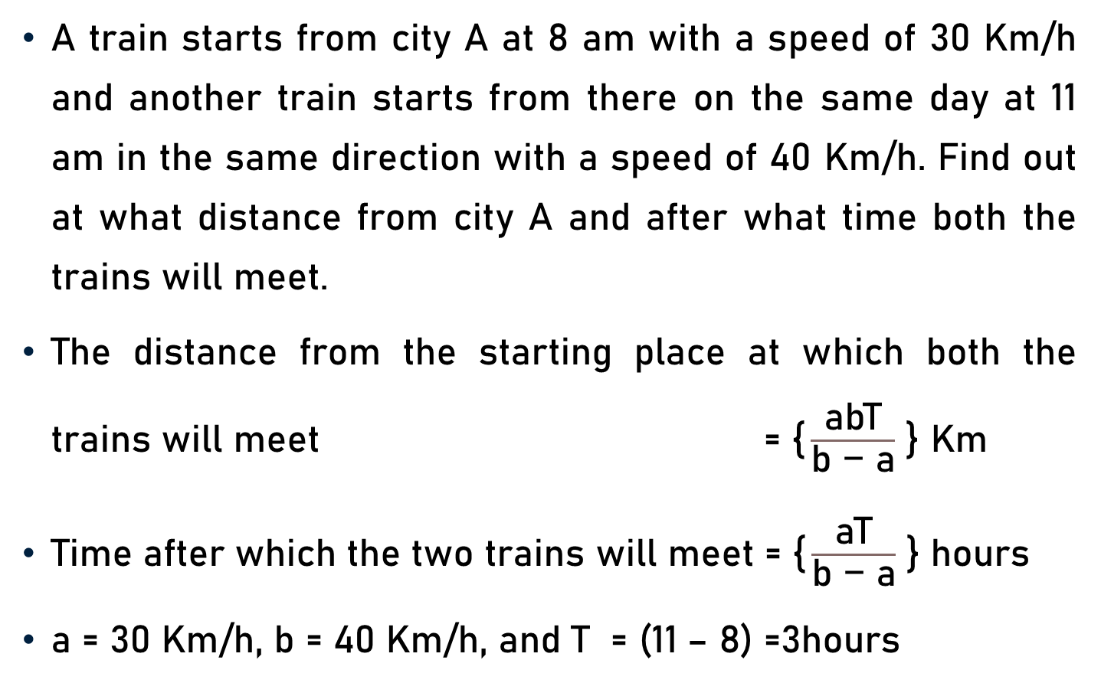
Problem 9
A train starts from city A at 8 am with a speed of 30 Km/h and another train starts from there on the same day at 11 am in the same direction with a speed of 40 Km/h. Find out at what distance from city A and after what time both the trains will meet.
The distance from the starting place at which both the trains will meet $\text{= \{}\frac{\text{abT}}{\text{b}\text{ − }\text{a}}$ } Km
Time after which the two trains will meet = $\text{\{}\frac{\text{aT}}{\text{b}\text{ − }\text{a}}$ } hours
a = 30 Km/h, b = 40 Km/h, and T = (11 – 8) =3hours

Slide 18
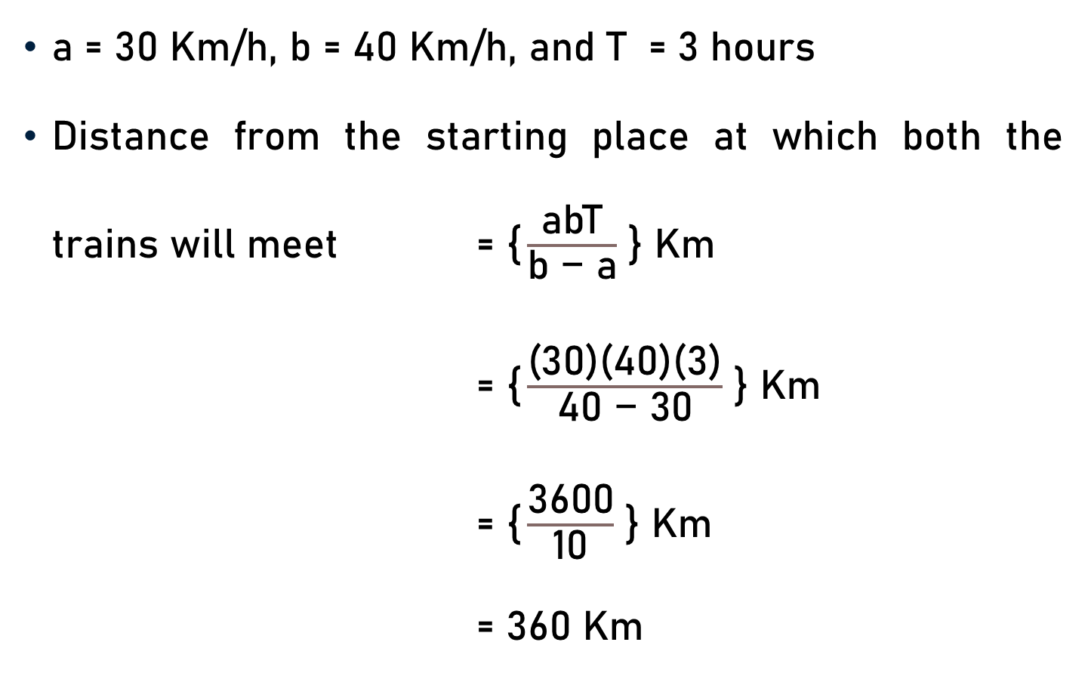
Problem 9
a = 30 Km/h, b = 40 Km/h, and T = 3 hours
Distance from the starting place at which both the trains will meet $\text{= }\text{\{}\frac{\text{abT}}{\text{b}\text{ − }\text{a}}$ } Km
$\text{= \{}\frac{\text{(30)(40)(3)}}{\text{40}\text{ − }\text{30}}$ } Km
$\text{= \{}\frac{\text{3600}}{\text{10}}$ } Km
$\text{= 360}$ Km

Slide 19
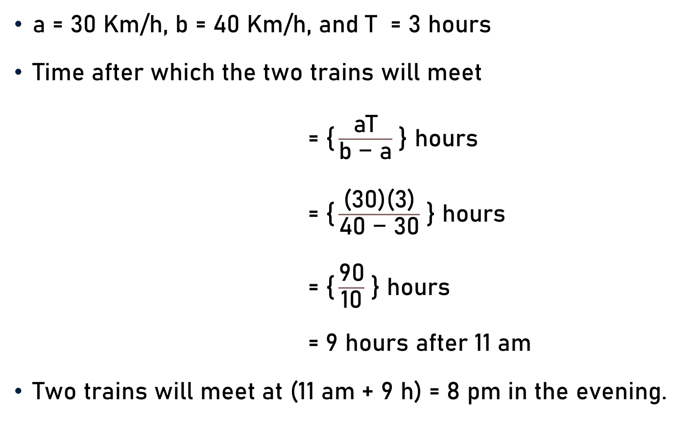
Problem 9
a = 30 Km/h, b = 40 Km/h, and T = 3 hours
Time after which the two trains will meet
= $\text{\{}\frac{\text{aT}}{\text{b}\text{ − }\text{a}}$ } hours
$\text{= \{}\frac{\text{(30)(3)}}{\text{40 − 30}}$ } hours
$\text{= \{}\frac{\text{90}}{\text{10}}$ } hours
$\text{= 9}$ hours after 11 am
Two trains will meet at (11 am + 9 h) = 8 pm in the evening.

Slide 20
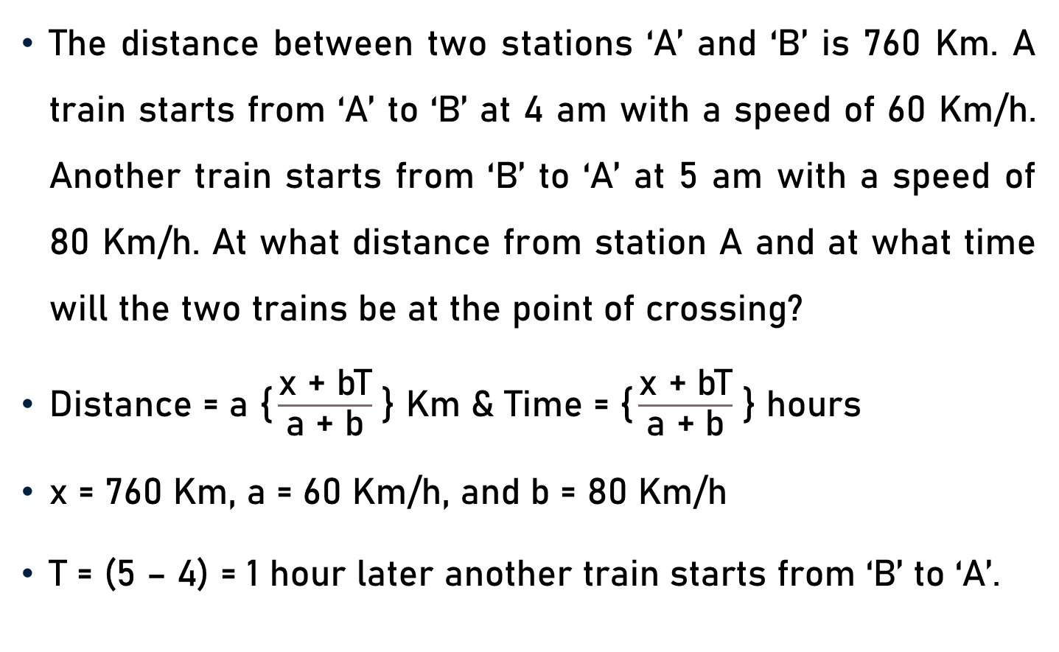
Problem 10
The distance between two stations ‘A’ and ‘B’ is 760 Km. A train starts from ‘A’ to ‘B’ at 4 am with a speed of 60 Km/h. Another train starts from ‘B’ to ‘A’ at 5 am with a speed of 80 Km/h. At what distance from station A and at what time will the two trains be at the point of crossing?
Distance = $\text{a}$ $\text{\{}\frac{\text{x}\text{ + }\text{bT}}{\text{a}\text{ + }\text{b}}$ } Km & Time = $\text{\{}\frac{\text{x}\text{ + }\text{bT}}{\text{a}\text{ + }\text{b}}$ } hours
x = 760 Km, a = 60 Km/h, and b = 80 Km/h
T = (5 – 4) = 1 hour later another train starts from ‘B’ to ‘A’.

Slide 21
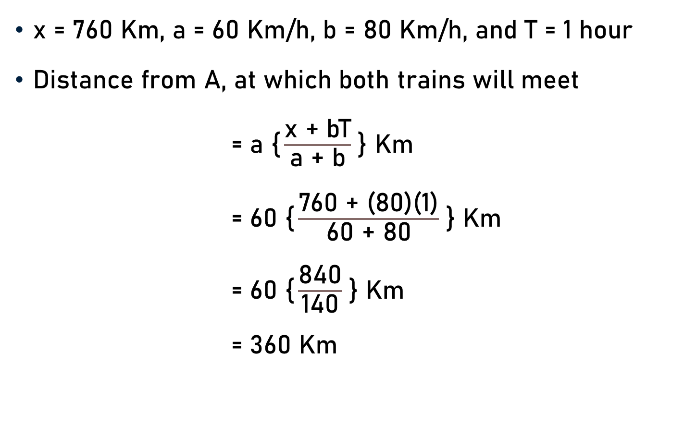
Problem 10
x = 760 Km, a = 60 Km/h, b = 80 Km/h, and T = 1 hour
Distance from A, at which both trains will meet
= $\text{a}$ $\text{\{}\frac{\text{x}\text{ + }\text{bT}}{\text{a}\text{ + }\text{b}}$ } Km
= 6$\text{0}$ $\text{\{}\frac{\text{760}\text{ + }\text{(80)(1)}}{\text{60}\text{ + }\text{80}}$ } Km
= 6$\text{0}$ $\text{\{}\frac{\text{8}\text{4}\text{0}}{\text{14}\text{0}}$ } Km
= 3$\text{60}$ Km
6

Slide 22
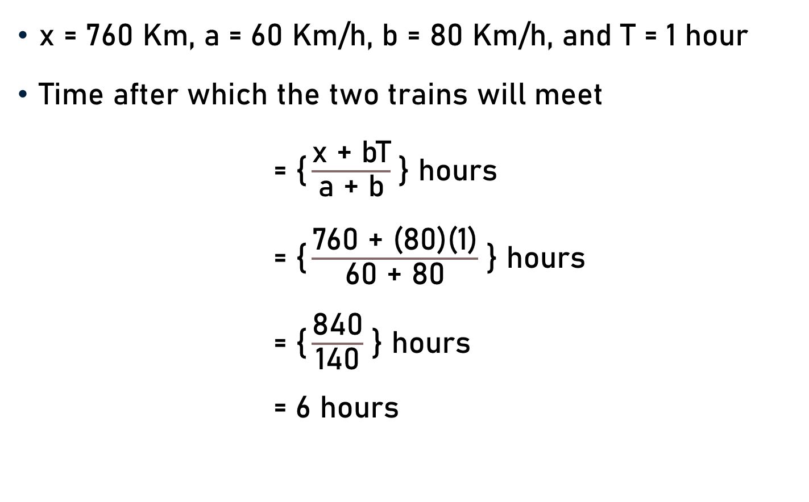
Problem 10
x = 760 Km, a = 60 Km/h, b = 80 Km/h, and T = 1 hour
Time after which the two trains will meet
= $\text{\{}\frac{\text{x}\text{ + }\text{bT}}{\text{a}\text{ + }\text{b}}$ } hours
= $\text{\{}\frac{\text{760}\text{ + }\text{(80)(1)}}{\text{60}\text{ + }\text{80}}$ } hours
= $\text{\{}\frac{\text{8}\text{4}\text{0}}{\text{14}\text{0}}$ } hours
= $\text{6}$ hours
6

Slide 23
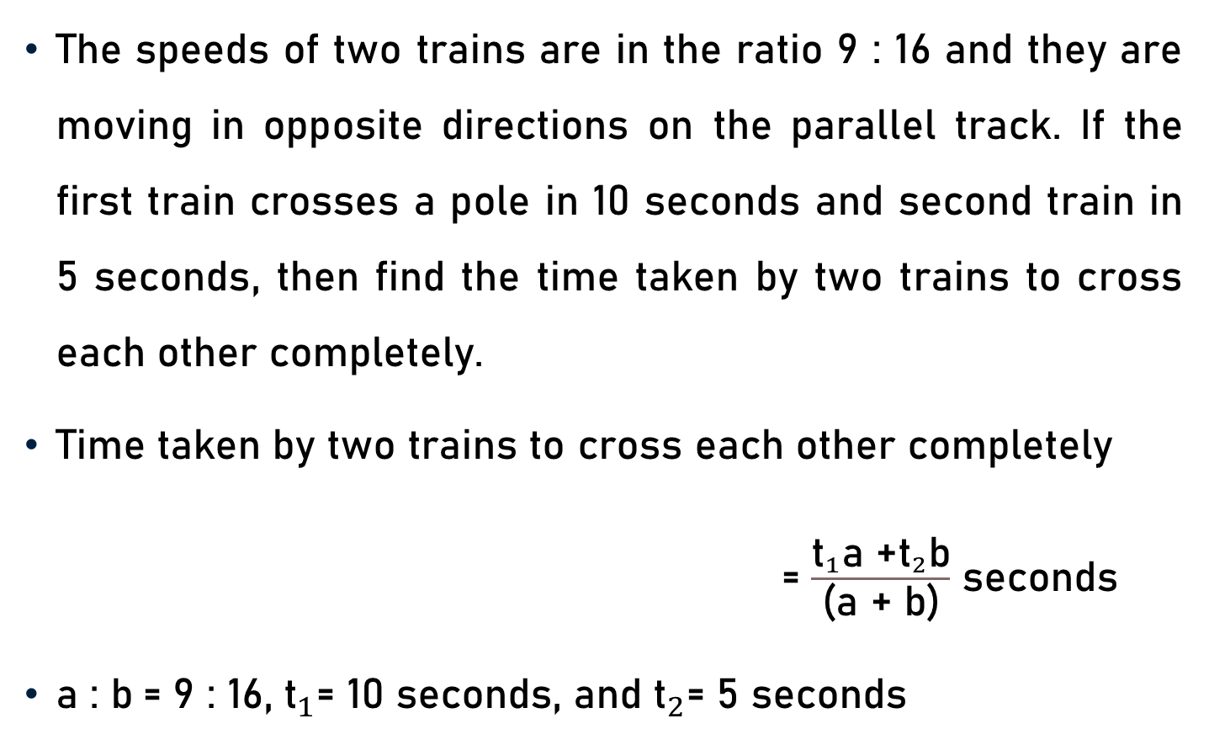
Problem 11
The speeds of two trains are in the ratio 9 : 16 and they are moving in opposite directions on the parallel track. If the first train crosses a pole in 10 seconds and second train in 5 seconds, then find the time taken by two trains to cross each other completely.
Time taken by two trains to cross each other completely
= $\frac{{\text{t}}_{1}\text{a}\text{ +}{\text{t}}_{2}\text{b}}{\text{(}\text{a} \text{+} \text{b}\text{)}}$ seconds
a : b$\text{= }$9 : 16, ${\text{t}}_{1}\text{= 10 }\text{seconds}\text{, }\text{and} {\text{t}}_{2}\text{=}$ 5 seconds

Slide 24
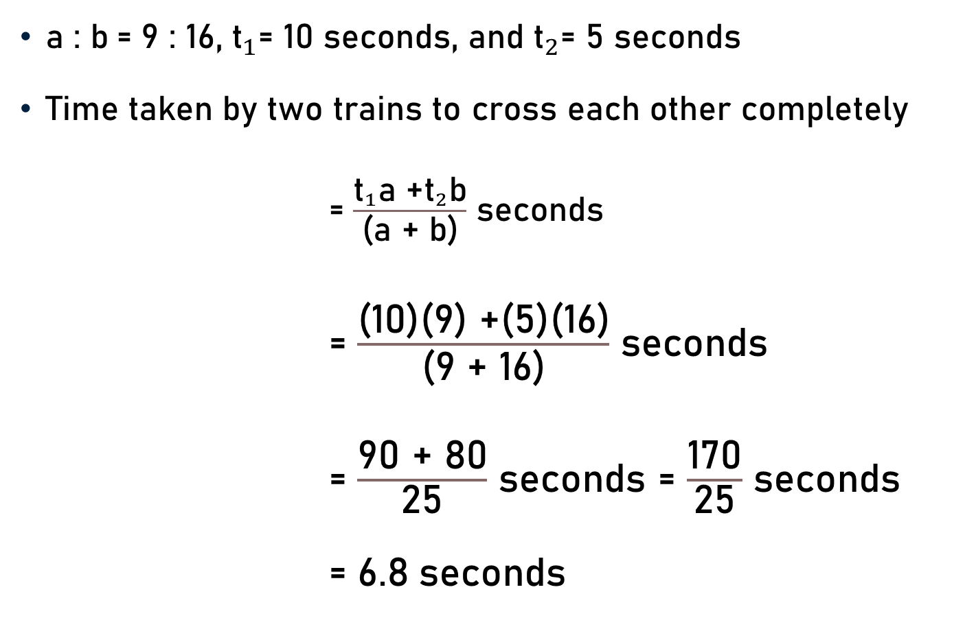
Problem 11
a : b$\text{= 9}$ : 16, ${\text{t}}_{1}\text{= 10 }\text{seconds}\text{, }\text{and} {\text{t}}_{2}\text{=}$ 5 seconds
Time taken by two trains to cross each other completely
= $\frac{{\text{t}}_{1}\text{a}\text{ +}{\text{t}}_{2}\text{b}}{\text{(}\text{a}\text{ + }\text{b}\text{)}}$ seconds
= $\frac{\text{(}\text{10}\text{)(9)}\text{ +(}\text{5}\text{)(}\text{16}\text{)}}{\text{(}\text{9}\text{ + }\text{16}\text{)}}$ seconds
= $\frac{\text{9}\text{0}\text{ +}\text{ 80}}{\text{25}}$ seconds = $\frac{\text{170}}{\text{25}}$ seconds
= $\text{6.8}$seconds
6.8

Slide 25
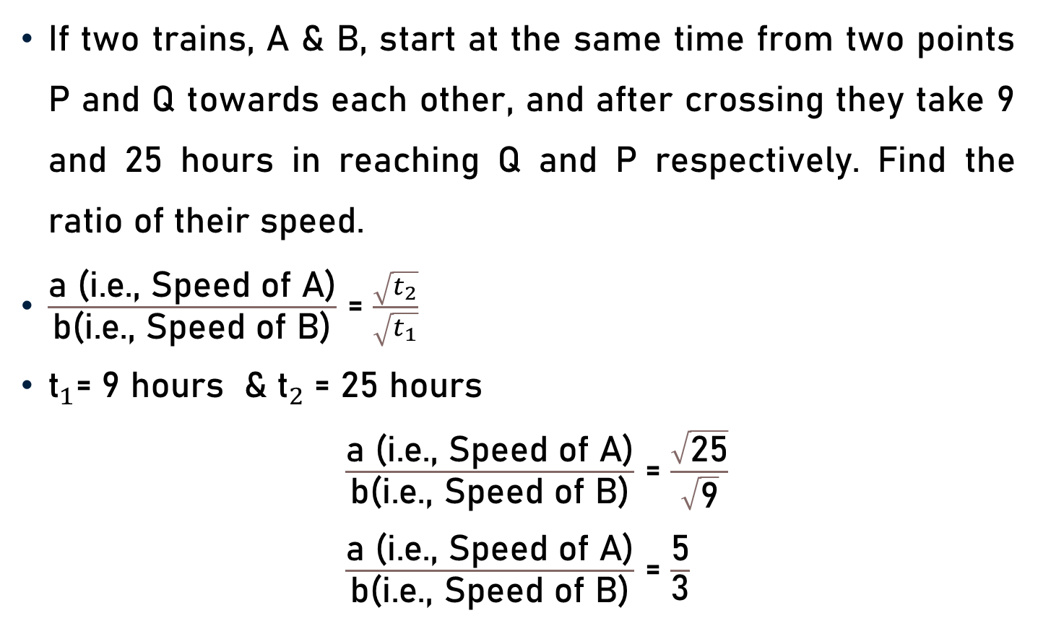
Problem 12
If two trains, A & B, start at the same time from two points P and Q towards each other, and after crossing they take 9 and 25 hours in reaching Q and P respectively. Find the ratio of their speed.
$\frac{\text{a}\text{ (}\text{i}\text{.}\text{e}\text{., }\text{Speed} \text{of} \text{A}\text{)}}{\text{b}\text{(}\text{i}\text{.}\text{e}\text{., }\text{Speed} \text{of} \text{B}\text{)}}$ = $\frac{\sqrt{t_{2}}}{\sqrt{t_{1}}}$
${\text{t}}_{1}$= 9 hours & ${\text{t}}_{2}$= 25 hours
$\frac{\text{a}\text{ (}\text{i}\text{.}\text{e}\text{., }\text{Speed} \text{of} \text{A}\text{)}}{\text{b}\text{(}\text{i}\text{.}\text{e}\text{., }\text{Speed} \text{of} \text{B}\text{)}}$ = $\frac{\sqrt{\text{25}}}{\sqrt{\text{9}}}$
$\frac{\text{a}\text{ (}\text{i}\text{.}\text{e}\text{., }\text{Speed} \text{of} \text{A}\text{)}}{\text{b}\text{(}\text{i}\text{.}\text{e}\text{., }\text{Speed} \text{of} \text{B}\text{)}}$ = $\frac{\text{5}}{\text{3}}$

Slide 26
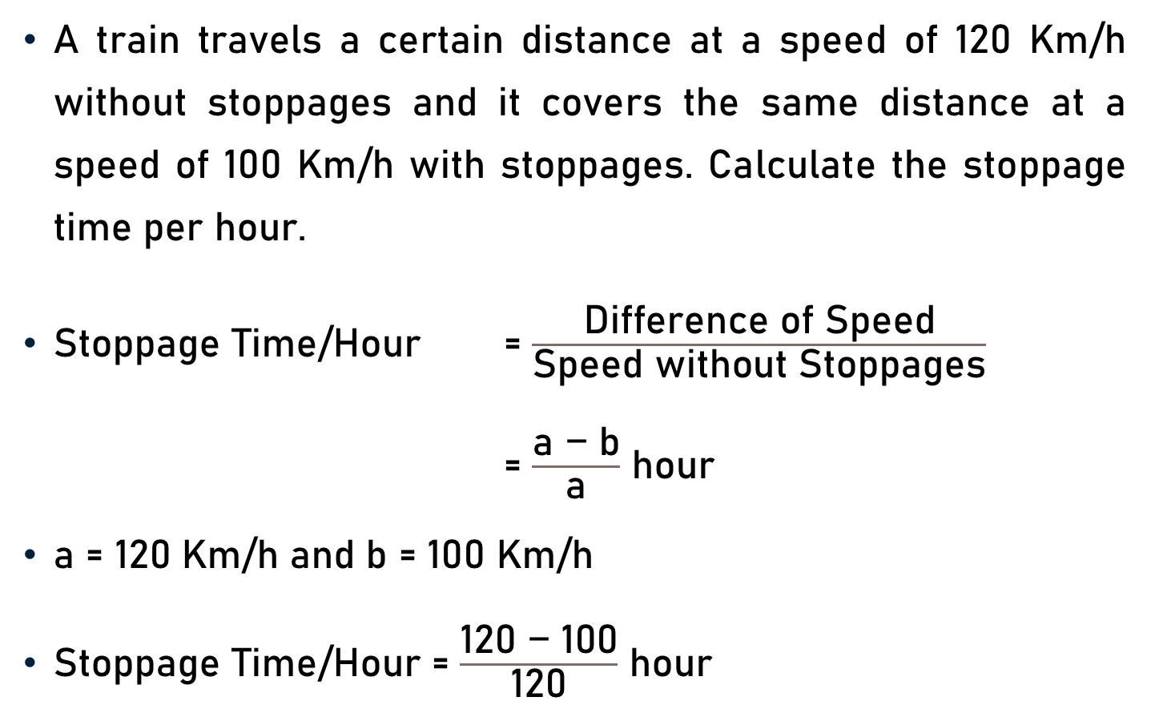
Problem 13
A train travels a certain distance at a speed of 120 Km/h without stoppages and it covers the same distance at a speed of 100 Km/h with stoppages. Calculate the stoppage time per hour.
Stoppage Time/Hour = $\frac{\text{Difference} \text{of} \text{Speed}}{\text{Speed} \text{without} \text{Stoppages}}$
= $\frac{\text{a}\text{ − }\text{b}}{\text{a}}$ hour
a = 120 Km/h and b = 100 Km/h
Stoppage Time/Hour = $\frac{\text{120}\text{ − }\text{100}}{\text{120}}$ hour

Slide 27
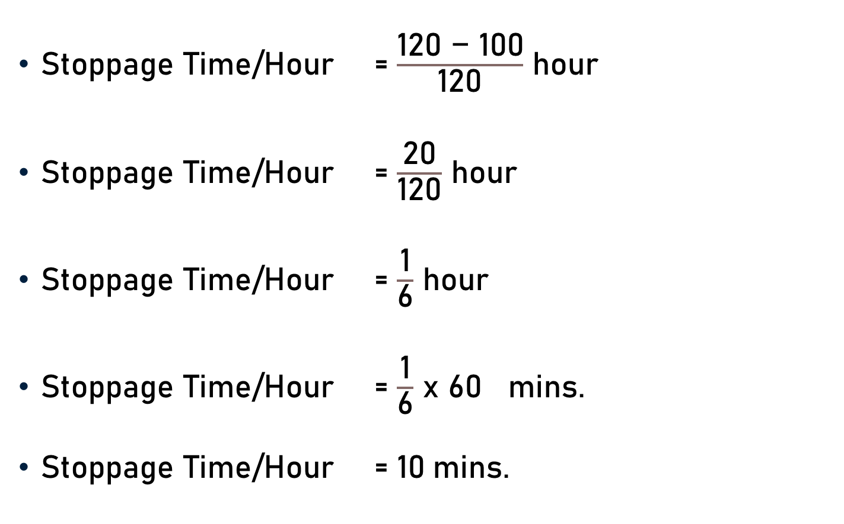
Problem 13
Stoppage Time/Hour = $\frac{\text{120 − 100}}{\text{120}}$ hour
Stoppage Time/Hour = $\frac{\text{20}}{\text{120}}$ hour
Stoppage Time/Hour = $\frac{\text{1}}{\text{6}}$ hour
Stoppage Time/Hour = $\frac{\text{1}}{\text{6}}$ x 60 mins.
Stoppage Time/Hour = $\text{1}\text{0}$mins.
6
10

Slide 28
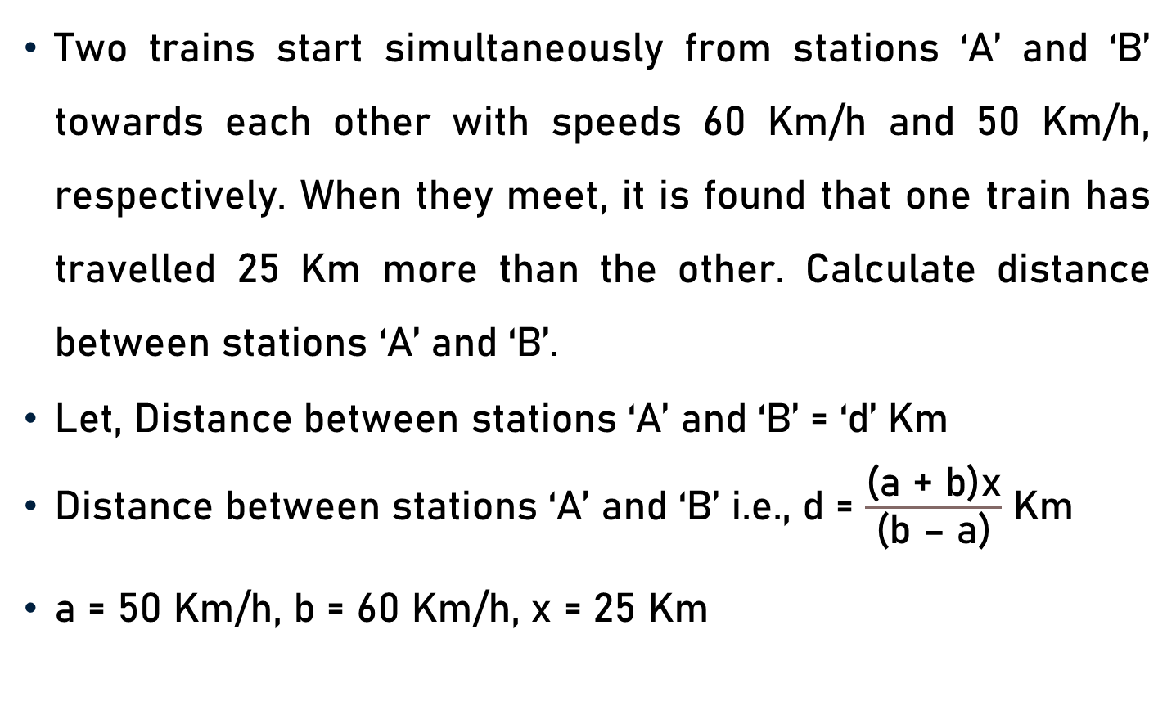
Problem 14
Two trains start simultaneously from stations ‘A’ and ‘B’ towards each other with speeds 60 Km/h and 50 Km/h, respectively. When they meet, it is found that one train has travelled 25 Km more than the other. Calculate distance between stations ‘A’ and ‘B’.
Let, Distance between stations ‘A’ and ‘B’ = ‘d’ Km
Distance between stations ‘A’ and ‘B’ i.e., d = $\frac{\text{(}\text{a}\text{ + }\text{b}\text{)}\text{x}}{\text{(}\text{b}\text{ – }\text{a}\text{)}}$ Km
a = 50 Km/h, b = 60 Km/h, x = 25 Km

Slide 29
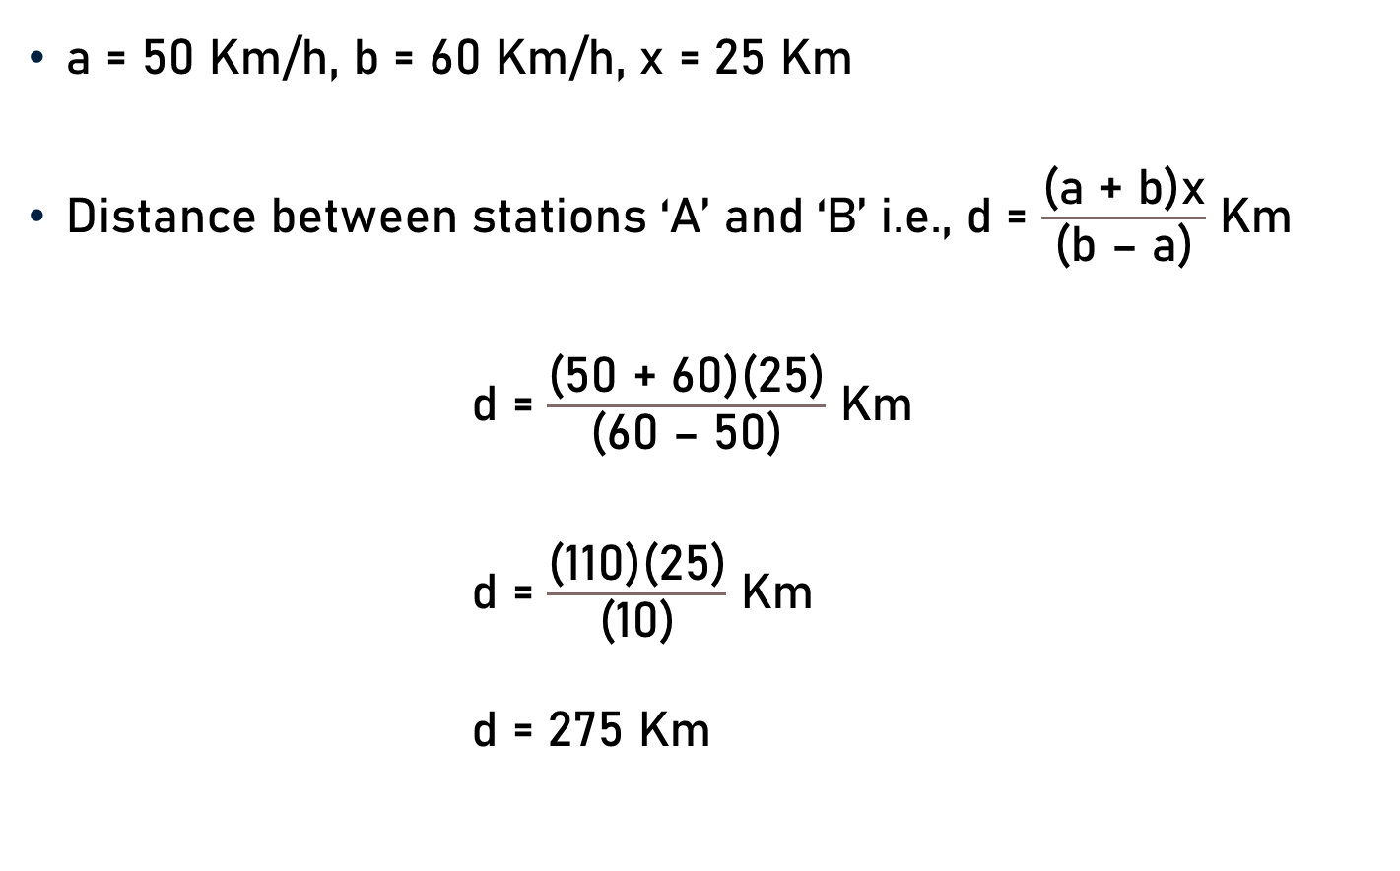
Problem 14
a = 50 Km/h, b = 60 Km/h, x = 25 Km
Distance between stations ‘A’ and ‘B’ i.e., d = $\frac{\text{(}\text{a}\text{ + }\text{b}\text{)}\text{x}}{\text{(}\text{b}\text{ – }\text{a}\text{)}}$ Km
d = $\frac{\text{(}\text{50}\text{ + }\text{60}\text{)}\text{(25)}}{\text{(}\text{60}\text{ – }\text{50}\text{)}}$ Km
d = $\frac{\text{(}\text{110}\text{)(25)}}{\text{(}\text{10}\text{)}}$ Km
d = $\text{2}\text{7}\text{5}$ Km
11

Slide 30
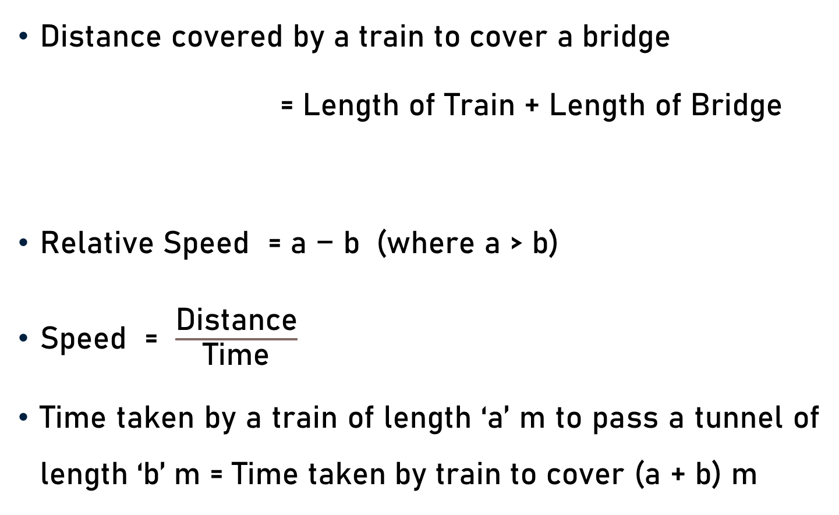
Conclusion
Distance covered by a train to cover a bridge
= Length of Train + Length of Bridge
Relative Speed = $\text{a}\text{ − }\text{b}$ (where a > b)
Speed = $\frac{\text{Distance}}{\text{Time}}$
Time taken by a train of length ‘a’ m to pass a tunnel of length ‘b’ m = Time taken by train to cover (a + b) m

Slide 31
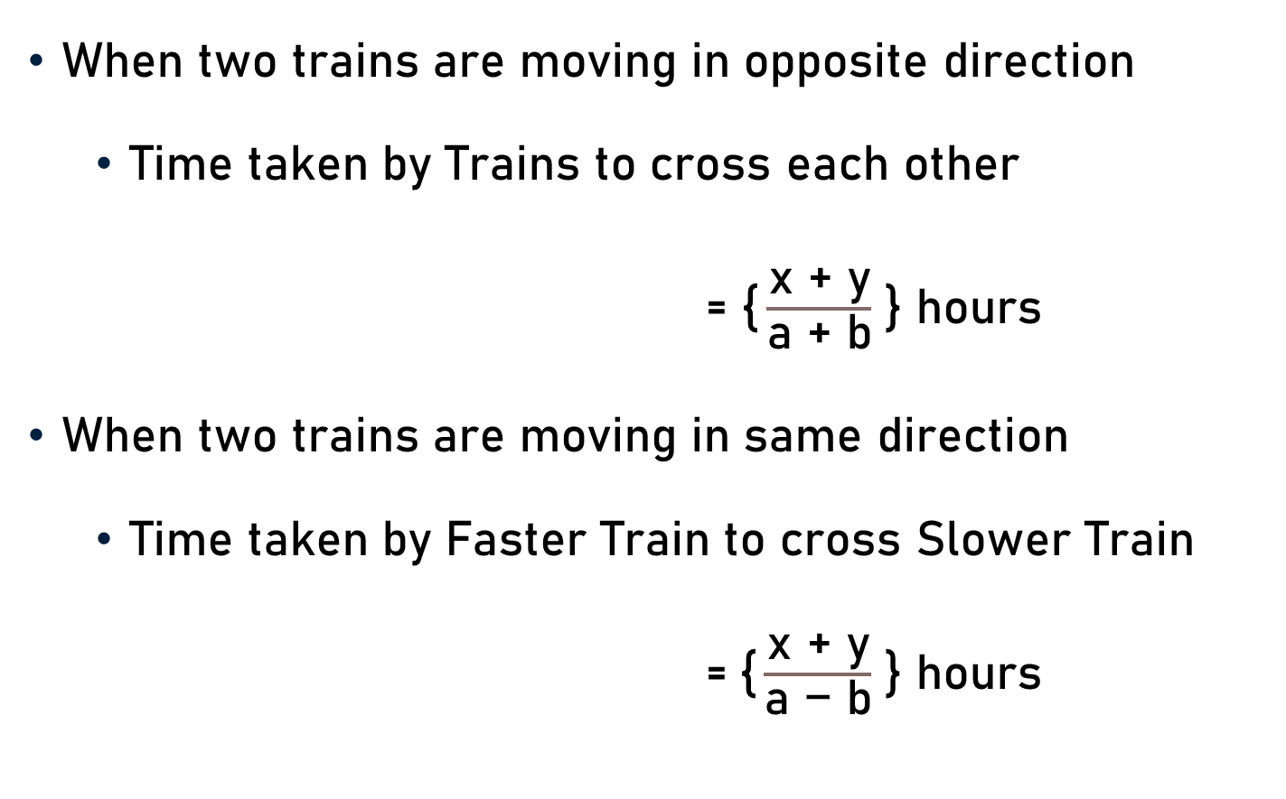
Conclusion
When two trains are moving in opposite direction
  Time taken by Trains to cross each other
= $\text{\{}\frac{\text{x}\text{ + }\text{y}}{\text{a}\text{ + }\text{b}}$ } hours
When two trains are moving in same direction
  Time taken by Faster Train to cross Slower Train
  =$\text{\{}\frac{\text{x}\text{ + }\text{y}}{\text{a}\text{ − }\text{b}}$ } hours

Slide 32
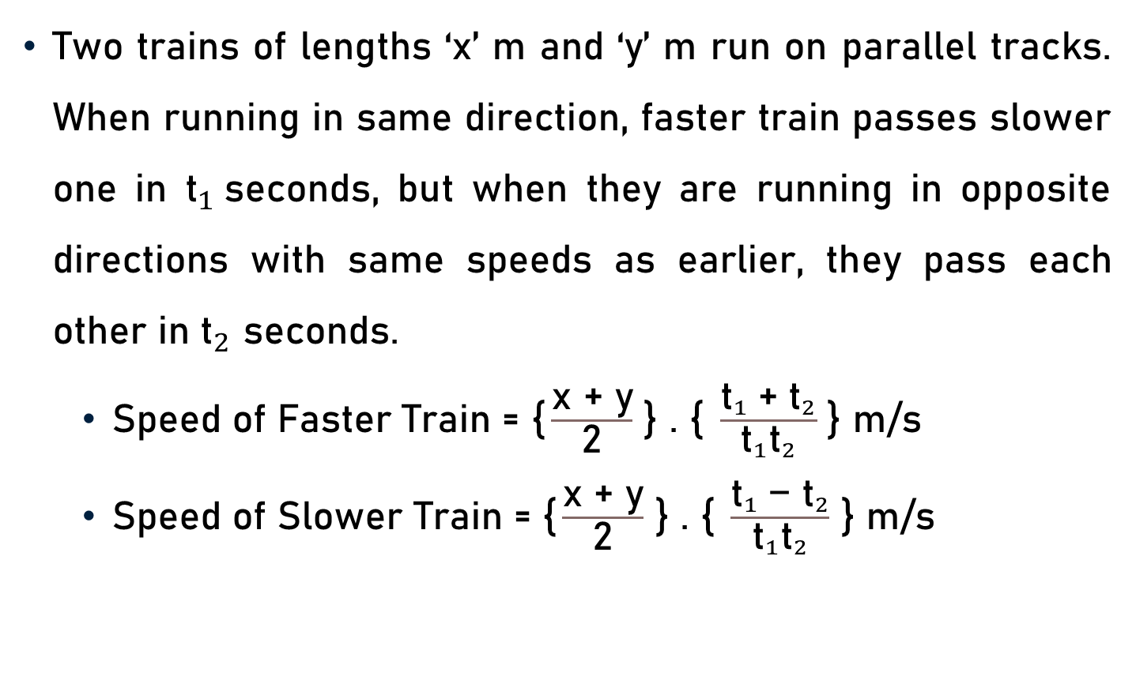
Conclusion
Two trains of lengths ‘x’ m and ‘y’ m run on parallel tracks. When running in same direction, faster train passes slower one in ${\text{t}}_{1}$seconds, but when they are running in opposite directions with same speeds as earlier, they pass each other in ${\text{t}}_{2}$ seconds.
  Speed of Faster Train = $\text{\{}\frac{\text{x}\text{ + }\text{y}}{\text{2}}$ } . $\text{\{} \frac{{{\text{t}}_{1} \text{+ }\text{t}}_{2}}{{\text{t}}_{1}{\text{t}}_{2}}$ } m/s
  Speed of Slower Train = $\text{\{}\frac{\text{x}\text{ + }\text{y}}{\text{2}}$ } . $\text{\{ }\frac{{{\text{t}}_{1} \text{− }\text{t}}_{2}}{{\text{t}}_{1}{\text{t}}_{2}}$ } m/s

Slide 33
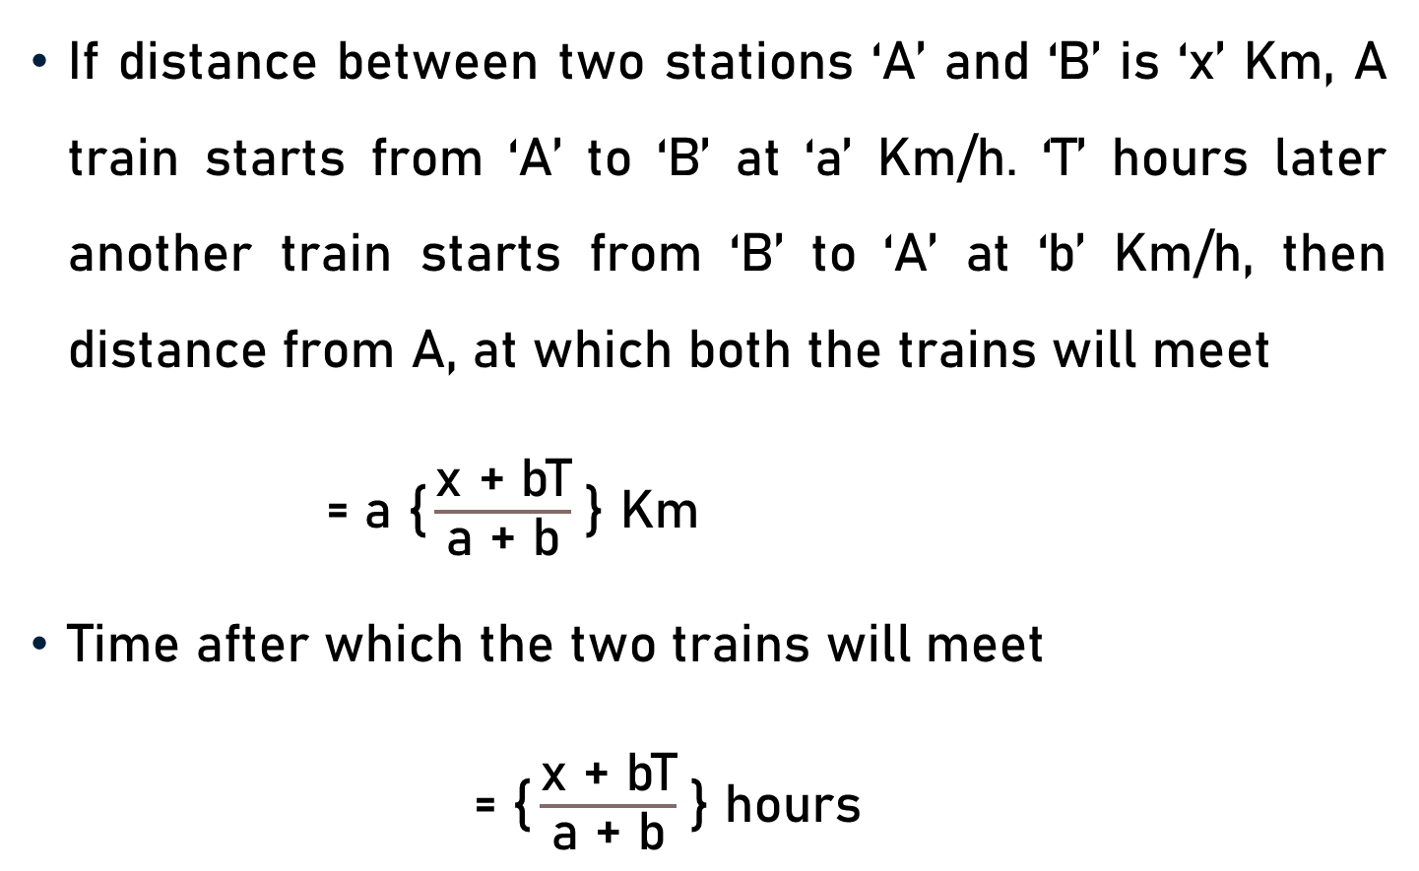
Conclusion
If distance between two stations ‘A’ and ‘B’ is ‘x’ Km, A train starts from ‘A’ to ‘B’ at ‘a’ Km/h. ‘T’ hours later another train starts from ‘B’ to ‘A’ at ‘b’ Km/h, then distance from A, at which both the trains will meet
= $\text{a}$ $\text{\{}\frac{\text{x}\text{ + }\text{bT}}{\text{a}\text{ + }\text{b}}$ } Km
Time after which the two trains will meet
= $\text{\{}\frac{\text{x}\text{ + }\text{bT}}{\text{a}\text{ + }\text{b}}$ } hours

Slide 34
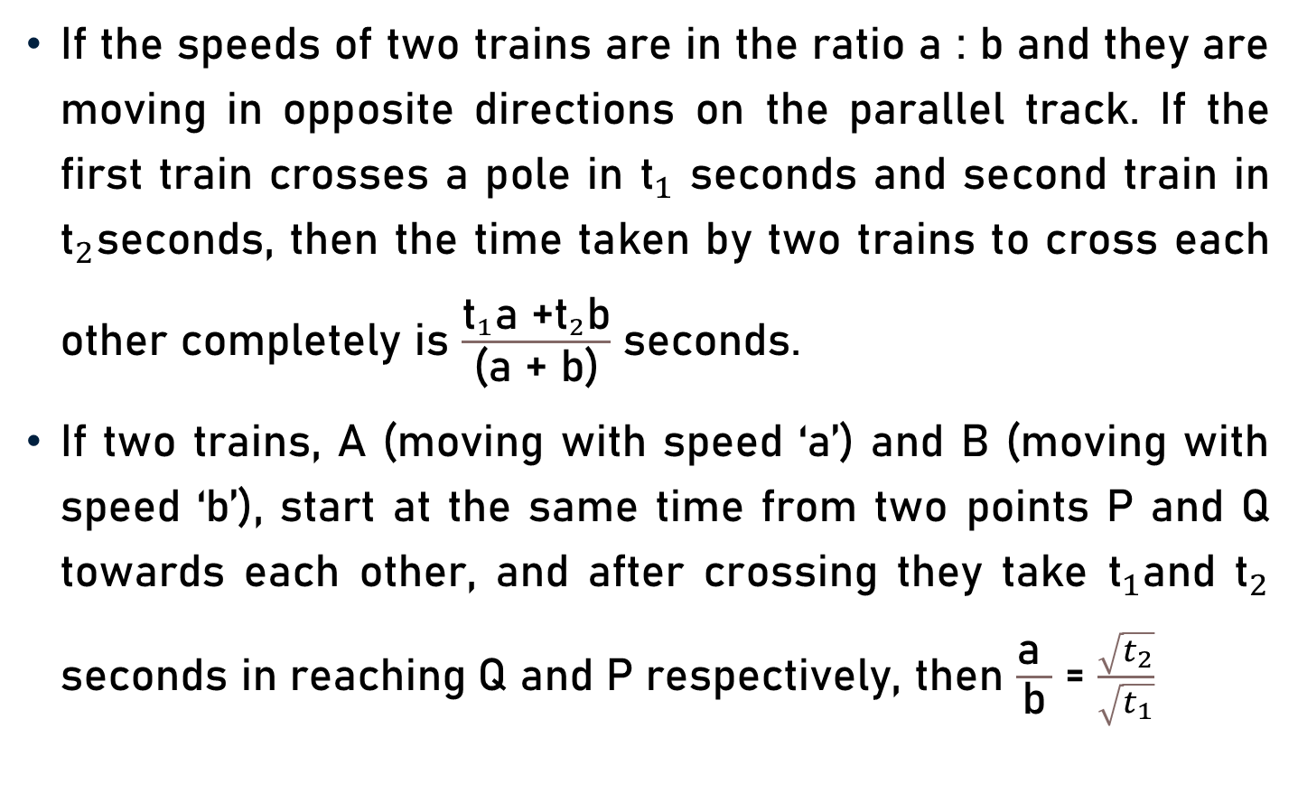
Conclusion
If the speeds of two trains are in the ratio a : b and they are moving in opposite directions on the parallel track. If the first train crosses a pole in ${\text{t}}_{1}$ seconds and second train in ${\text{t}}_{2}$seconds, then the time taken by two trains to cross each other completely is $\frac{{\text{t}}_{1}\text{a}\text{ +}{\text{t}}_{2}\text{b}}{\text{(}\text{a}\text{ + }\text{b}\text{)}}$ seconds.
If two trains, A (moving with speed ‘a’) and B (moving with speed ‘b’), start at the same time from two points P and Q towards each other, and after crossing they take ${\text{t}}_{1}$and ${\text{t}}_{2}$ seconds in reaching Q and P respectively, then $\frac{\text{a} }{\text{b}}$ = $\frac{\sqrt{t_{2}}}{\sqrt{t_{1}}}$

Slide 35
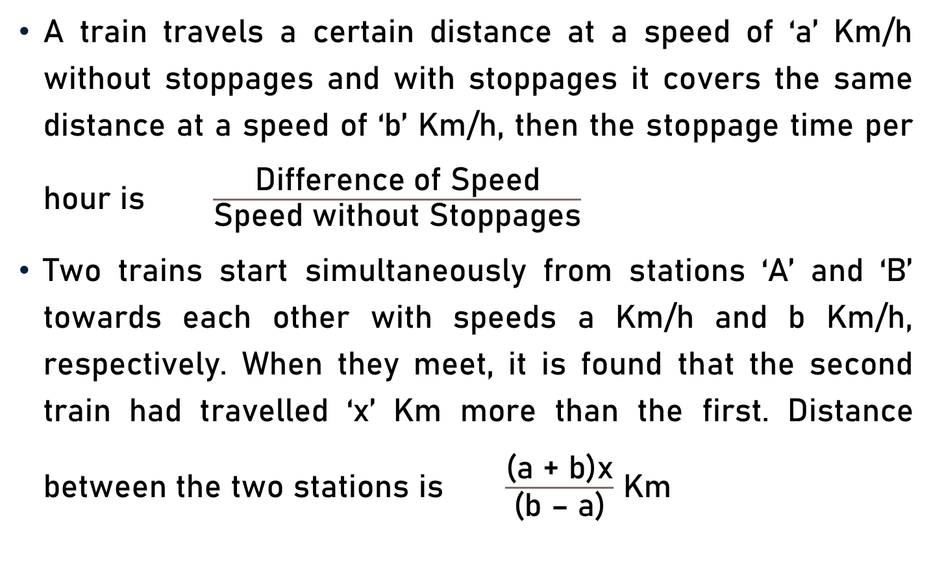
Conclusion
A train travels a certain distance at a speed of ‘a’ Km/h without stoppages and with stoppages it covers the same distance at a speed of ‘b’ Km/h, then the stoppage time per hour is $\frac{\text{Difference} \text{of} \text{Speed}}{\text{Speed} \text{without} \text{Stoppages}}$
Two trains start simultaneously from stations ‘A’ and ‘B’ towards each other with speeds a Km/h and b Km/h, respectively. When they meet, it is found that the second train had travelled ‘x’ Km more than the first. Distance between the two stations is $\frac{\text{(}\text{a}\text{ + }\text{b}\text{)}\text{x}}{\text{(}\text{b}\text{ – }\text{a}\text{)}}$ Km

Slide 36
Summary
Problems on Trains

